Slide 1

Chess AI using Machine Learning – Self Play
By Kuzey Cimen
Supervisor: Professor John Gan

Slide 2
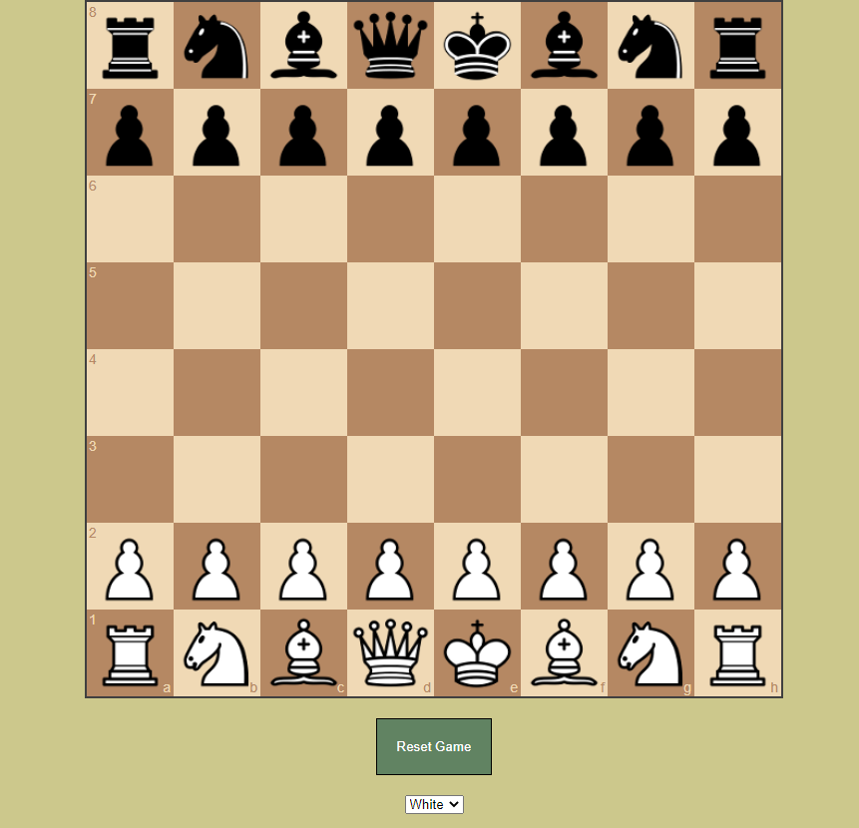
Now
Board on a website and live update using Flask and REST.
Frontend is JS and backend is Python.
Playable against AI.
AI is currently using minimax.
Gets total value of pieces in each colour at current board state to find best move.
Playable with both colours.
Promotions

Slide 3
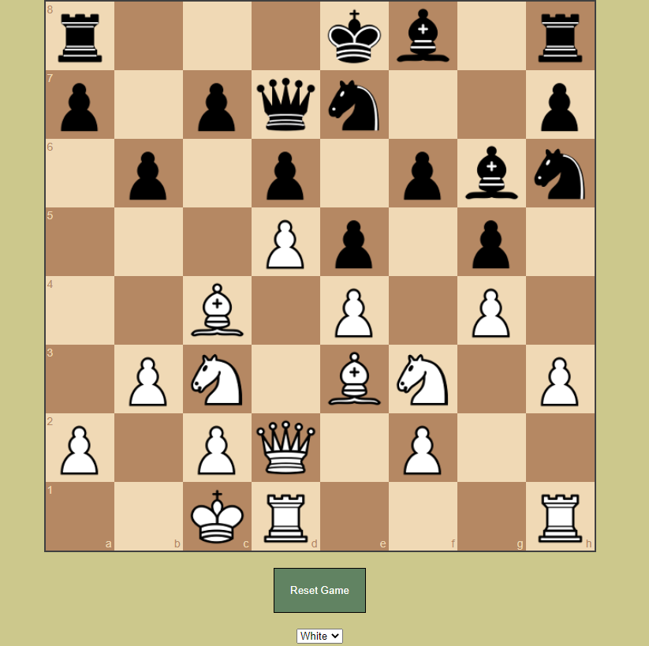
Future
Will use Monte Carlo Tree Search.
Implement machine learning.
Write a better evaluation function.
Add more functionality to the system such as:
Watching AI vs AI.
Seeing if the move user made was the best possible move (Helping the user learn).
Maybe let AI learn with a database of multiple high level games.

Slide 4
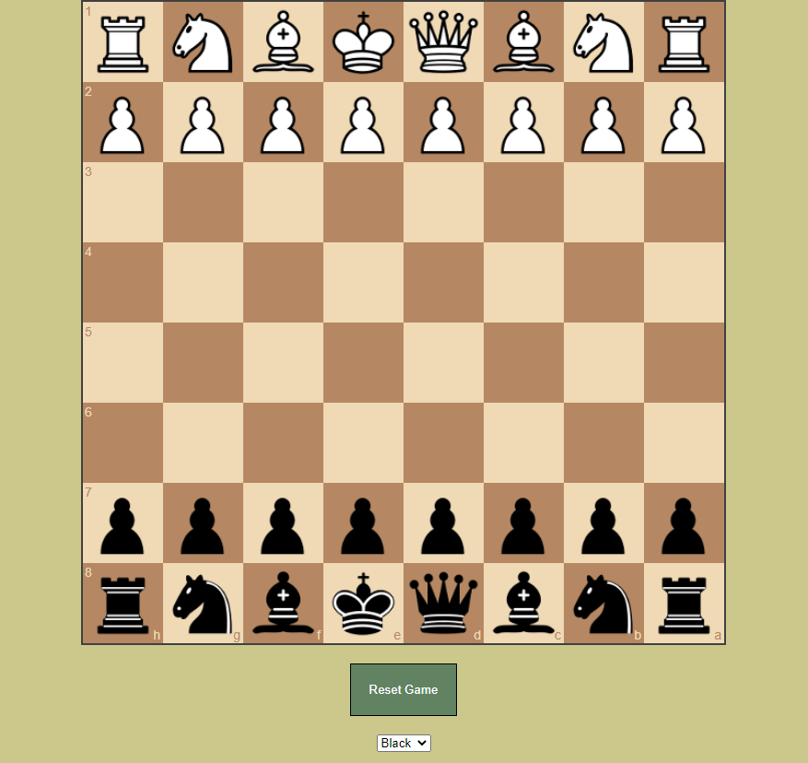
Research
Learn More:
Better evaluation function.
Policy function.
Monte Carlo Tree Search Implementation.
Reinforcement Learning.

